Slide 1
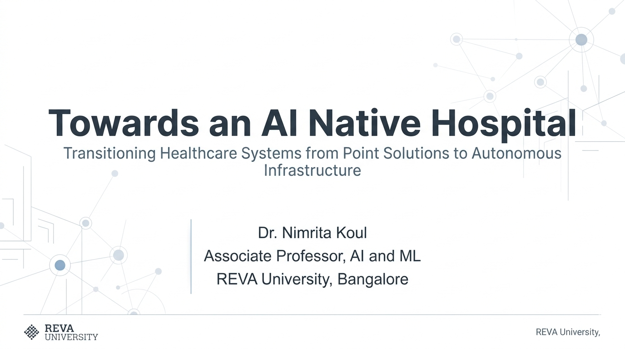

Slide 2
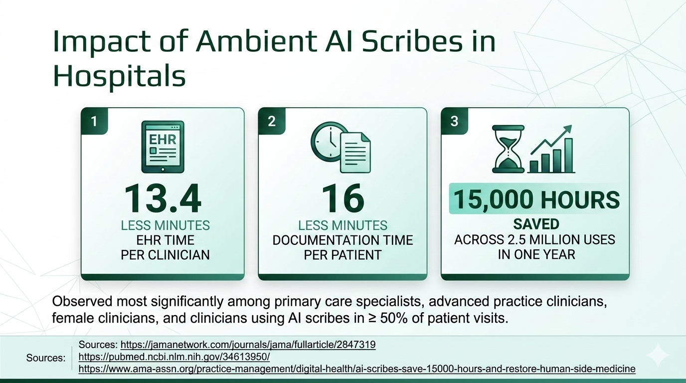

Slide 3
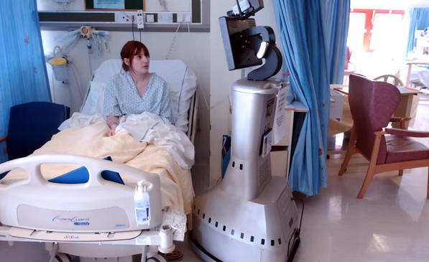
World’s first AI native hospital
The $5 billion hospital at UT Austin Dell Medical Center is expected to begin construction this winter and to complete in 2030. By 2035, AI and robots will run nearly 60% of hospital operations.
Source: https://www.statesman.com/news/healthcare/article/ut-austin-dell-ai-hospital-timeline-cost-vote-22381784.php

Slide 4
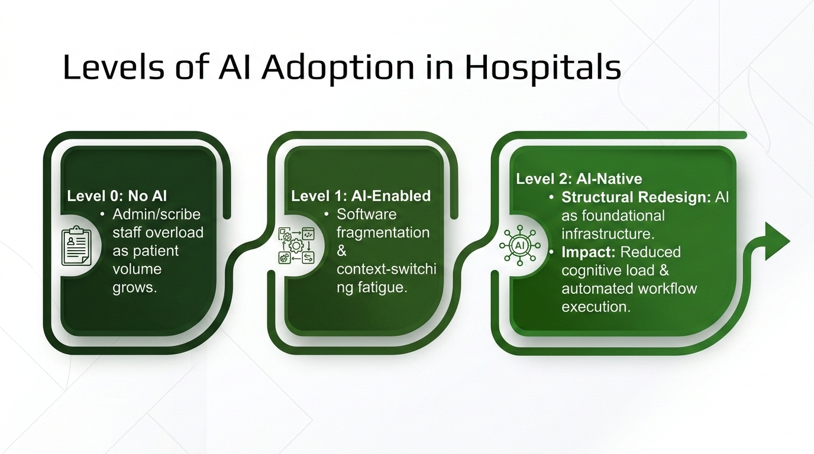

Slide 5
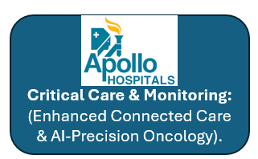
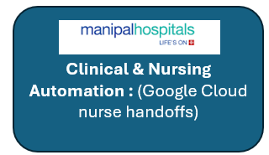
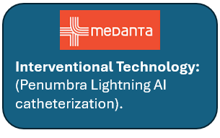
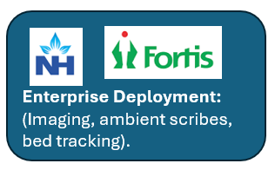
Some AI Powered (Level 1) Hospitals in India

Slide 6
AI Adoption in Hospitals
Operational Vector | Level 0: No AI (Legacy HIS) | Level 1: AI-Enabled (Point Add-Ons) | Level 2: AI-Native (Hospital OS)
Data & Architecture | Siloed Databases | Connected Silos | Single Unified Intelligence Layer
Workflow Trigger | Manual & Sequential | Trigger-Based Alerts | Closed-Loop Actions by AI Agents
Clinical Scribing & Notes | Manual Transcription | Point Dictation / Scribe Tool | Ambient Intelligence
Insurance Pre-Auth & Claims | Manual Paperwork | Automated Extraction | Agentic Pre-Authorization
Governance & Regulatory | Manual Checklists | Added-On Compliance | Native Guardrails. CDSCO regulations, human-in-the-loop checks
System Improvement | Static Software Upgraded every 5–7 | Vendor Updates | Continuous Self Learning

Slide 7
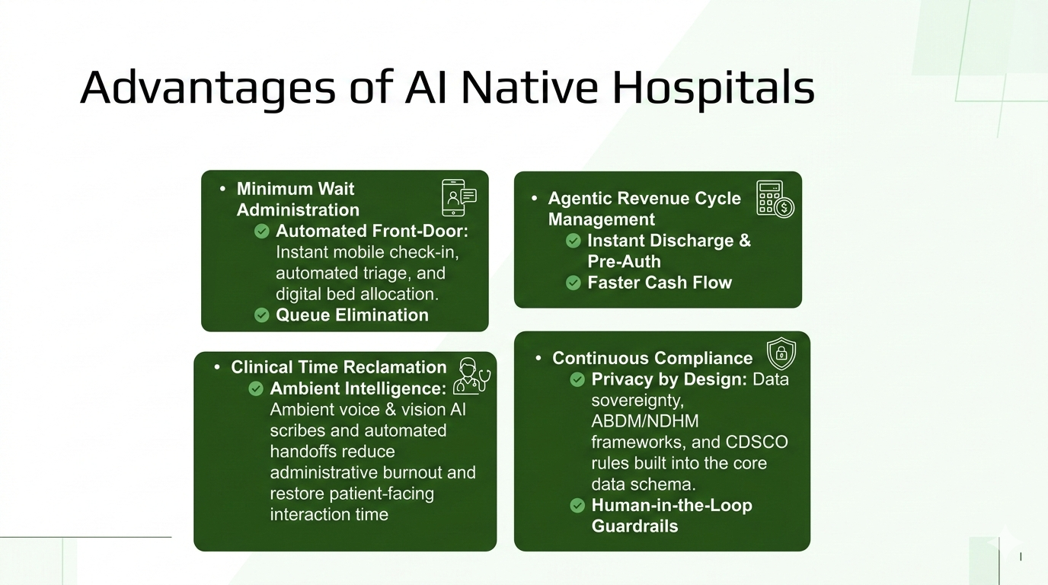

Slide 8
Prerequisites to building an AI native hospital
Infrastructure First:
Treat AI as core operational infrastructure, not modular add-ons.
Workflow Redesign:
Re-engineer clinical protocols before buying or procuring technology.
Value Metric:
Measure ROI via clinical hours reclaimed, capacity unlocked, and claim denial rate reductions.

Slide 9
Hospitals’ Regulatory Accountability
Compliance & Device Registration
  Adhere strictly to national DPDP laws, ABDM data sovereignty, and CDSCO Medical Device Rules.
Clinical Governance & Liability
  Attending physicians retain 100% diagnostic authority & legal accountability.
  Mandatory sign-off protocols for all algorithmic suggestions.
Auditing & Safety
  Audit the algorithmic accuracy across diverse patient demographics periodically.

Slide 10
Conclusion
Being AI-Native does not mean throwing away your existing HIS. It involves wrapping an intelligent orchestration layer around it.
Technology alone won't fix a broken process. We re-engineer the clinical protocol first, then let the AI orchestration layer automate it.
AI agents serve as decision support tools with strict human-in-the-loop sign-offs. Full diagnostic and legal authority rests with the attending physicians.

Slide 11

Google Drive Link:
https://tinyurl.com/AINativeHospital11Oct2026

Slide 12
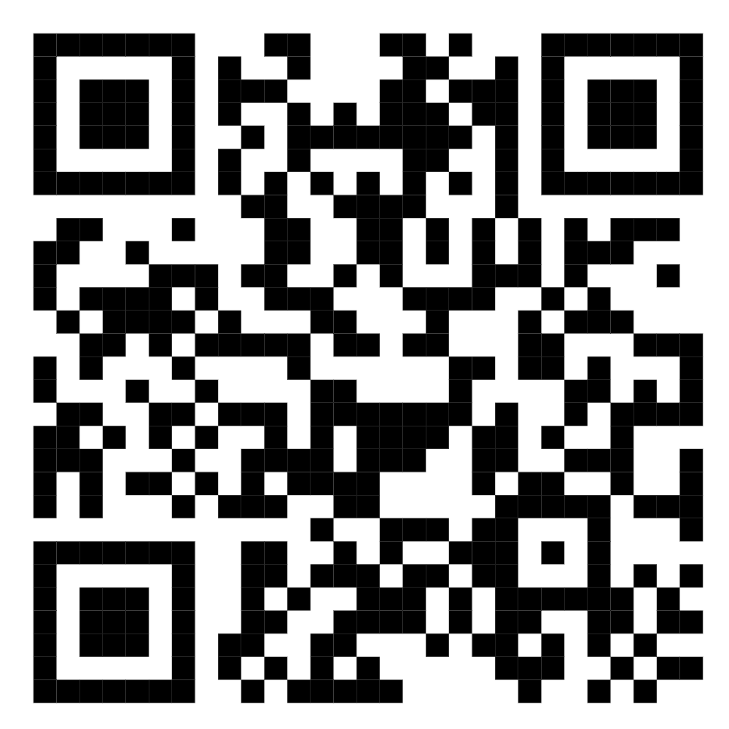
GitHub: https://github.com/NimritaKoul/AINativeHospitals11Oct2026_IIMRaipur

Slide 13
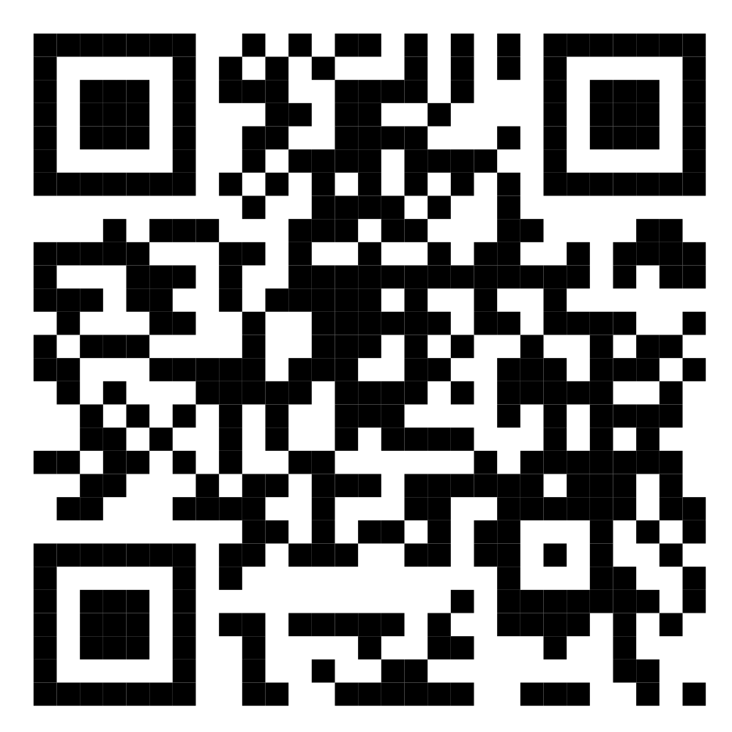
Live Interactive Agent Walkthrough: https://zapier.com/

